Slide 1


GMR Institute of Technology, Rajam
Enhancing Waste Management Through Deep Learning-Based Trash Classification
5-Jun-24
1
5-Jun-24
1

Slide 2
Enhancing Waste Management Through Deep Learning-Based Trash Classification
N.Kalyan (21341A05C1)
K. Kavyasree (21341A0585)
M.Poleswarao (21341A05A0)
L.Raju (21341A0590)
L.Ajay kumar (21341A0591)
Under the guidance of
Ms. K. B. Krishnaveni
Assistant Professor
GMR Institute of Technology

Slide 3
Abstract
Efficient waste management is becoming increasingly crucial in modern society to mitigate environmental impact and promote sustainability. The conventional method of waste sorting depends on manual labour, a process that is time-consuming and ineffective. However, with advancements in computer vision technology, automating garbage classification has become increasingly feasible, offering improved efficiency and management. Leveraging the TrashNet dataset, the system classifies waste into six categories, namely (Cardboard, Glass, Metal, Paper, Plastic, Trash/Non-Recyclable). Four distinct deep learning architectures-DenseNet121, MobilenetV3, VGG16 and a Convolutional Neural Network (CNN) are implemented to analyze and categorize images of diverse waste items. The utilization of multiple architectures allows for comparative analysis of their effectiveness in waste classification. The project emphasizes the importance of robust waste sorting systems for efficient recycling practices. Evaluation metrics such as accuracy and precision, recall are employed to assess the performance of the model. Results obtained from the diverse deep learning models contribute valuable insights into the optimization of trash classification methods, with implications for sustainable waste management and environmental conservation.
Keywords: Garbage classification automation, Deep Learning, Convolutional Neural Network (CNN), DenseNet121, Mobilenet, VGG16.

Slide 4
Base Paper
Ma, Xiaoxuan, Zhiwen Li, and Lei Zhang. "An improved ResNet-50 for garbage image classification." Tehnički vjesnik 29.5 (2022): 1552-1559.
In This paper garbage picture categorization research can be done using many classification model but mainly using ResNet model.
It uses CBAM(Convolutional Block Attention Module) consists of two components: the channel attention module (CAM) and the spatial attention module (SAM).
Both global average pooling and max pooling are commonly used operations in convolutional neural networks (CNNs) for dimensionality reduction and feature extraction. They help in summarizing the information in the feature maps and providing a compact representation for further processing and classification
The six types of wastes are mentioned are glass, cardboard, metal, paper, plastic, and trash.
accuracy of ResNet-50 is 92.08%.

Slide 5
Introduction
Imagine a world where waste sorting is no longer a manual, time-consuming task, but an automated process, handled with precision by machines. This technology could be integrated into smart bins, enabling them to automatically sort waste into the correct categories, thereby increasing the efficiency of recycling processes.In addition, this technology could be used in waste treatment facilities to automate the process of separating recyclables from non-recyclables, reducing human error and increasing the overall efficiency of waste management. Now, let's move on to our project. We are tackling the pressing issue of waste classification by leveraging the power of the Vgg16 algorithm on the TrashNet dataset, a dataset known for its limited data and similar-looking waste types. Our primary focus is efficiency and accuracy in classifying waste into six distinct categories: Cardboard, Glass, Metal, Paper, Plastic, and Trash or Non-Recyclable items. Through meticulous testing and analysis of our model, we aim to fine-tune the settings, or parameters, for the Vgg16. Our goal is to achieve the highest possible accuracy on the TrashNet dataset. Furthermore, we will delve into how different optimization techniques impact waste image classification. We are on a quest to discover the most effective approach to enhance our model's performance.

Slide 6
This project, with its emphasis on a proven algorithm, Vgg16, and simpler models, aspires to deliver a practical solution for waste classification. The insights we gain from this project will contribute significantly to smarter waste management practices. We aim to provide valuable insights for optimizing waste classification methods, thereby promoting progress towards sustainable waste handling and environmental protection.

Slide 7
Literature survey
Reference 1:
Shi, C., Tan, C., Wang, T., & Wang, L. (2021). A waste classification method based on a multilayer hybrid convolution neural network. Applied Sciences, 11(18), 8572.
The objectives of the paper are focused on improving waste classification accuracy using a multilayer hybrid convolution neural network and evaluating the performance of the proposed method on the TrashNet dataset.
The proposed method involves preprocessing waste images, extracting image features, normalizing the features, and using the Softmax classifier for classification.
The MLH-CNN method provides good feature extraction ability, focusing on the main target and effectively extracting features, leading to improved classification performance.

Slide 8
Literature survey
Reference 2 :
Melinte, D. O., Travediu, A. M., & Dumitriu, D. N. (2020). Deep convolutional neural networks object detector for real-time waste identification. Applied Sciences, 10(20), 7301.
The study aims to compare the performance of different CNN architectures trained on the TrashNet dataset and evaluate their precision, recall, and F1 score.
The focus is on developing an accurate and fast CNN architecture for waste detection, which is crucial for applications like waste collection by autonomous robots.
The paper also discusses the optimization of learning rate during training and the use of different loss optimization methods.

Slide 9
Literature survey
Reference 3 :
Kang, B., & Jeong, C. S. (2023). ARTD-Net: Anchor-Free Based Recyclable Trash Detection Net Using Edgeless Module. Sensors, 23(6), 2907.
The paper discusses the need for automatic systems for separate waste collection using deep learning and computer vision techniques.
It proposes two anchor-free-based recyclable trash detection networks (ARTD-Net1 and ARTD-Net2) that efficiently recognize overlapped multiple wastes of different types.
The paper concludes that the proposed ARTD-Net1 and ARTD-Net2 methods achieve competitive performance in mean average precision and F1 score compared to other deep learning models.

Slide 10
Literature survey
Reference 4 :
Yang, J., Zeng, Z., Wang, K., Zou, H., & Xie, L. (2021). GarbageNet: a unified learning framework for robust garbage classification. IEEE Transactions on Artificial Intelligence, 2(4), 372-380.
The paper presents a novel incremental learning framework called GarbageNet for garbage classification, addressing challenges such as lack of data, high cost of category increment, and noisy data quality.
The paper contributes to the field of AI for the environment, promoting environmental ethics, rotation economy, and relieving the pressure of consumption doctrine in smart cities.
The GarbageNet framework utilizes weakly-supervised transfer learning for feature extraction, embedding new categories as anchors for reference, and classifying test samples by finding their nearest neighbors in the latent space.

Slide 11
Literature survey
Reference 5 :
Chen, Z., Yang, J., Chen, L., & Jiao, H. (2022). Garbage classification system based on improved ShuffleNet v2. Resources, Conservation and Recycling, 178, 106090.
The paper introduces the use of deep learning technology for garbage classification and mentions previous studies that have used deep learning algorithms for this purpose.
The self-built garbage image dataset used in the study consists of four categories of household garbage: recyclable garbage, wet garbage, hazardous garbage, and dry garbage.
The paper presents the improvements made to ShuffleNet v2, including the parallel mixed attention mechanism (PMAM), the use of FReLU activation function, and transfer learning.

Slide 12
Literature survey
Reference 6:
Wahyutama, Aria Bisma, and Mintae Hwang. "YOLO-based object detection for separate collection of recyclables and capacity monitoring of trash bins." Electronics 11.9 (2022): 1323.
This paper researches on the trash and recycled material identification using Alexnet CNN and making the robot application
The research is tested on two different ways one is identifying the indoor images and other is detecting the outdoor images
The author Integrating this image processing-based classification into smart trash cans will be more suitable for cleaning garbage
The robot detect the outdoor images and classify it to take the object or not(two classes take or non take)
This paper achieved the accuracy of 92% on the trash net dataset and 93.6% on the outdoor images by the Alexnet CNN

Slide 13
Literature survey
Reference 7:
Sultana, Rumana, et al. "Trash and recycled material identification using convolutional neural networks (CNN)." 2020 SoutheastCon. IEEE, 2020.
The paper focus on a incremental learning framework called GarbageNet for garbage classification, addressing challenges such as lack of data, new categories, and noisy data quality.
The author proposed the incremental learning method for future adding components, the model should learn and classify newly builted objects
In this article the AFM(attentive feature mixup) is used to leverage the noisy garbage data So, it can classify the objects in the different classes
The proposed method achieved state-of-the-art performance in terms of accuracy, robustness, and extendibility, winning the first place in the HUAWEI Cloud Garbage Classification Challenge in 2019

Slide 14
Literature survey
Reference 8:
Yang, Jianfei, et al. "GarbageNet: a unified learning framework for robust garbage classification." IEEE Transactions on Artificial Intelligence 2.4 (2021): 372-380.
The paper describes the development of a smart trash bin that uses a webcam and YOLO real-time object detection to separate and collect recyclables into their correct categories. The YOLO model achieved an accuracy of 91% under optimal computing conditions and 75% when deployed on a Raspberry Pi .
The performance of the YOLO model was evaluated using the mAP measurement method, which assesses the average accuracy of object classification, box drawing, and the model's confidence in generating predictions .
The system also incorporates hardware such as ultrasonic sensors for measuring trash bin capacity and GPS for locating trash bin coordinates. This information is uploaded to Firebase Database via the ESP8266 Wi-Fi module and displayed on a mobile application in real-time .
The study aims to solve the recyclable waste separation problem in rural areas.

Slide 15
Literature survey
Reference 9:
Teng, X., Fei, Y., He, K., & Lu, L. (2022, July). The Object Detection of Underwater Garbage with an Improved YOLOv5 Algorithm. In Proceedings of the 2022 International Conference on Pattern Recognition and Intelligent Systems (pp. 55-60).
The paper proposes the use of YOLOv5 as the object detection algorithm for detecting and clearing underwater garbage using Autonomous Underwater Vehicles (AUVs).
The paper introduces improvements to the YOLOv5 algorithm, including re clustered anchor boxes using the improved KMeans++ algorithm and replacing the box loss function with CIoU .
Evaluation metrics used in the research include precision (P), recall (R), and mAP, with precision and recall being basic indicators and mAP calculating the average AP value of different types of garbage
The improved YOLOv5 algorithm in the paper achieves a detection accuracy of 88.7% and a mean average precision (mAP) of 90.6% on the trash_ICRA19 dataset, which is 9.6% higher than previous studies.

Slide 16
Reference 10:
Gondal, A. U., Sadiq, M. I., Ali, T., Irfan, M., Shaf, A., Aamir, M., ... & Kantoch, E. (2021). Real time multipurpose smart waste classification model for efficient recycling in smart cities using multilayer convolutional neural network and perceptron. Sensors, 21(14), 4916.
The authors discuss the challenges faced by cities in waste management due to rapid urbanization and the need for automatic waste classification and management systems .
The paper presents a hybrid approach using a multilayer perceptron and a multilayer convolutional neural network (ML-CNN) for waste classification .
The authors highlight the importance of better recycling of waste to reduce the amount of waste sent to landfills and the need for efficient waste classification techniques .
The proposed model utilizes a camera placed in front of a waste conveyor belt to capture images of the waste for classification
The model achieves high accuracy in waste classification, with a training, testing, and validation accuracy of 0.99% under different training batches and input features.

Slide 17
Literature survey
Reference 11:
Xiao, J. (2022, March). A waste image classification using convolutional neural networks and ensemble learning. In Proceedings of the 6th International Conference on Control Engineering and Artificial Intelligence (pp. 29-33).
The paper compares a single convolutional neural network (CNN) model and an ensemble model based on CNNs for garbage classification, finding that the ensemble model achieves higher accuracy .
Previous works have also explored garbage classification using CNN models, such as Public GarbageNet, which can identify multiple types of domestic garbage with high accuracy .
The paper considers the problem of image-based garbage classification and compares different CNN models (Xception, VGG16, ResNet, DenseNet, Inception) and ensemble learning methods (random forest, AdaBoost, XGBoost, deep neural network), finding that ensemble learning generally outperforms single CNN models.
Waste classification is seen as essential for sustainable development, and the paper's findings suggest that ensemble learning models have promising applications in garbage classification systems.

Slide 18
Literature survey
Reference 12:
Ma, Xiaoxuan, Zhiwen Li, and Lei Zhang. "An improved ResNet-50 for garbage image classification." Tehnički vjesnik 29.5 (2022): 1552-1559.
In This paper garbage picture categorization research can be done using many classification model but mainly using ResNet model.
It uses CBAM(Convolutional Block Attention Module) consists of two components: the channel attention module (CAM) and the spatial attention module (SAM).
Both global average pooling and max pooling are commonly used operations in convolutional neural networks (CNNs) for dimensionality reduction and feature extraction. They help in summarizing the information in the feature maps and providing a compact representation for further processing and classification
The six types of wastes are mentioned are glass, cardboard, metal, paper, plastic, and trash.
accuracy of ResNet-50 is 92.08%,

Slide 19
Literature survey
Reference 13 :
Mittal, Ishika, et al. "Trash classification: classifying garbage using deep learning." Journal of engineering sciences 11.7 (2020).
The paper presents a deep learning algorithm that accurately classifies images of garbage, improving waste management and segregation processes
CNN is a type of Deep Learning algorithm which accepts input in the form of images ,In this paper it collects the waste images using Stereo camera and finnaly detect the object to classify images into different categories like glass, paper, plastic, metal , cardboard .
In CNN is trained under 7 layers due to size and resolution of images and gives better output.
In this 4 types of dataset is used and combined it get different classes like Glass, paper, plastic,cardboard, metal, Organic and recyclable

Slide 20
Literature survey
Reference 14 :
Pandey, Ayush, et al. "Enhancing Waste Management: Automated Classification of Biodegradable and Non-biodegradable Waste using CNN.
The paper proposes an automated waste classification system using Convolutional Neural Networks (CNNs) to improve waste management and also to classify waste into biodegradable and non-biodegradable categories
Research has compared different CNN architectures such as VGG, Inception, ResNet, and others to determine the optimal model for waste classification tasks
Input layer preprocesses waste image data, convolutional layers extract features, activation layers introduce nonlinearity, pooling layers reduce dimensionality, and dropout layers prevent overfitting. Fully connected layers map features to output nodes, and the output layer determines waste classification probabilities using SoftMax.
accuracy of 99.23% in categorizing plastic garbage into 4 categories

Slide 21
Literature survey
Reference 15:
Ramsurrun, Nadish, et al. "Recyclable waste classification using computer vision and deep learning." 2021 zooming innovation in consumer technologies conference (ZINC). IEEE, 2021.
In this paper our work proposes a Deep Learning approach using computer vision to automatically
identify the type of waste and classify it into five main categories: plastic, metal, paper, cardboard and glass.
Also compare two Machine Learning techniques, Support Vector Machine (SVM) and Convolutional Neural Network (CNN) also known as AlexNet) for the classification of waste into five main classes (glass, paper, metal, plastic, cardboard).
They reached a 92% accuracy and used Raspberry Pi to open the bin where images are sent using LoRaWan connectivity

Slide 22
Literature survey
Reference 16:
Wang, Y., Zhao, W. J., Xu, J., & Hong, R. (2020). Recyclable waste identification using cnn image recognition and gaussian clustering. arXiv preprint arXiv:2011.01353.
The paper proposes a convolutional neural network (CNN) model for waste identification and classification, using transfer learning from a pretrained Resnet-50 CNN for feature extraction .
The model utilizes a sliding-window process for image segmentation in the pre-classification stage and Gaussian Clustering to locate the objects in the post classification stage.
The model achieves an overall detection rate of 48.4% in simulation and a final classification accuracy of 92.4% .
The TrashNet dataset is augmented for training the model, which contains 2527 RGB waste images labeled with six categories: cardboard, glass, metal, paper, plastic, and trash
Previous works in waste object classification have focused on single object identification, while this study combines mass detection with high performance identification

Slide 23
Literature survey
Reference 17 :
Yang, M., & Thung, G. (2016). Classification of Trash for Recyclability Status; CS229 Project Report.
The paper proposes a computer vision approach to classify garbage into recycling categories using support vector machines (SVM) with scale-invariant feature transform (SIFT) features and a convolutional neural network (CNN) .
The authors collected a dataset of around 400-500 images for each class, including glass, paper, metal, plastic, cardboard, and trash .
Radial basis kernels were found to be the best for image datasets, and the SVM's C parameter was set to 1000, while gamma was set to 0.5 .
Various image transformations were performed to account for different orientations of recycled material and maximize the dataset size .
The SVM was chosen as the initial classification algorithm due to its simplicity and effectiveness

Slide 24
Literature survey
Reference 18 :
He, Y., Gu, Q., & Shi, M. (2020). Trash Classification Using Convolutional Neural Networks Project Category: Computer Vision.
The project aimed to provide an automated waste sorting tool using Convolutional Neural Networks (CNN) and explored several well-known architectures, including modified AlexNet, dropout, data augmentation, and learning rate decay.
The project followed U.S. standards on sorting recyclables and developed a model that takes an image of waste and outputs a vector with probabilities of six categories: cardboard, glass, metal, paper, plastic, and trash. The model used linear activation function and categorical hinge loss function .
The authors plan to explore other models like VGG and ResNet and utilize transfer learning for higher accuracy. They also aim to upgrade the tool to classify waste according to more detailed rules for different countries like Japan and China .
The project observed that data augmentation could be helpful, and models with partial data augmentation achieved higher final test accuracy. However, adding dropout did not give obvious improvement to test accuracy
The highest test accuracy achieved was 79.94% with partial data augmentation and a Support Vector Machine (SVM) classifier

Slide 25
Literature survey
Reference 19:
Awe, O., Mengistu, R., & Sreedhar, V. Final Report Smart Trash Net Waste Localization and Classification. arXiv 2017. preprint.
The paper focuses on waste localization and classification using Faster R-CNN, a region-based object detection model.
The authors propose a fine-tuned Faster R-CNN architecture to categorize waste into landfill, recycling, and paper.
The dataset used for training and evaluation is generated by composing images from the TrashNet dataset.
The performance of the model is evaluated using precision-recall curves and the average precision (AP) metric.
The paper discusses the challenges faced, such as bias issues and the use of a white background that may affect the classification of paper waste

Slide 26
Literature survey
Reference 20:
Kulkarni, Hrushikesh N., and Nandini Kannamangalam Sundara Raman. "Waste object detection and classification." CS230 Stanford (2019).
The paper discusses the use of Hybrid Transfer Learning for waste object classification and Faster R-CNN for object detection.
The authors propose an architecture that utilizes GANs for creating collages and a fine-tuned Faster R-CNN for object detection .
The dataset used in the study consists of collaged images with different waste objects, including glass, plastic, paper, trash, metal, and cardboard.
The authors mention the use of the TrashNet dataset as a baseline, which contains images of different waste objects divided into six labeled classes .
Different classifiers were experimented with, including ResNet, and it was found that ResNet worked the best for robust classification

Slide 27
Literature survey
Reference 21:
Majchrowska, Sylwia, et al. "Deep learning-based waste detection in natural and urban environments." Waste Management 138 (2022): 274-284.
The paper provides a critical analysis of over ten existing waste datasets and reviews existing deep learning-based waste detection approaches.
The authors propose new benchmark datasets, "detect-waste" and "classify-waste," which are merged collections from open-source datasets with unified annotations covering various waste categories.
The paper presents a two-stage detector for litter localization and classification, using EfficientDet-D2 for localization and EfficientNet-B2 for classification. The classifier is trained in a semi-supervised fashion using unlabeled images.
The authors compare different datasets representing outdoor, indoor, and underwater scenarios, and they use the Mask R-CNN architecture for instance segmentation. EfficientNet-B2 is used for classification, which outperformed ResNet-50 and EfficientNet-B4.

Slide 28
Literature survey
Reference 22:
Yuan, Zhen, and Jinfeng Liu. "A hybrid deep learning model for trash classification based on deep trasnsfer learning." Journal of Electrical and Computer Engineering 2022 (2022).
The paper proposes a hybrid deep learning model for trash classification based on deep transfer learning, which consists of upper and lower streams.
The upper stream divides the input garbage image into category MPP (metal, paper, and plastic class) or category CGT (cardboard, glass, and trash class).
The lower stream predicts the exact class of trash based on the results of the upper stream.
The proposed model achieves the best result with 98.5% accuracy compared to state-of-the-art approaches.
The authors acknowledge the current limitations of the paper, such as the model not being deployed in real systems and the dataset not considering garbage classification under complex backgrounds

Slide 29
Literature survey
Reference 23:
Zheng, Dashun, et al. "Focus-RCNet: a lightweight recyclable waste classification algorithm based on focus and knowledge distillation. " Visual Computing for Industry, Biomedicine, and Art 6.1 (2023): 19.
The paper proposes a lightweight network architecture called Focus-RCNet, which uses deeply separable convolution and a Focus module to extract features from waste images. The SimAM attention mechanism is introduced to reduce the dimensionality of features while retaining relevant information.
The experiments were conducted on the TrashNet dataset, which consists of 2528 waste images divided into six categories: paper, glass, plastic, metal, cardboard, and trash.
The model's performance was compared with other models such as ShuffleNet, MobileNet, and DenseNet on the same dataset..
The limitations of the study include the need for further verification on other datasets, exploration of model limitations and improvements, comparison with other garbage classification models, and exploration of the model's application in other fields
The proposed model achieved an accuracy of 92% and showed high deployment mobility.

Slide 30
Literature survey
Reference 23:
Zheng, Dashun, et al. "Focus-RCNet: a lightweight recyclable waste classification algorithm based on focus and knowledge distillation. " Visual Computing for Industry, Biomedicine, and Art 6.1 (2023): 19.
The paper proposes a lightweight network architecture called Focus-RCNet, which uses deeply separable convolution and a Focus module to extract features from waste images. The SimAM attention mechanism is introduced to reduce the dimensionality of features while retaining relevant information.
The experiments were conducted on the TrashNet dataset, which consists of 2528 waste images divided into six categories: paper, glass, plastic, metal, cardboard, and trash.
The model's performance was compared with other models such as ShuffleNet, MobileNet, and DenseNet on the same dataset..
The limitations of the study include the need for further verification on other datasets, exploration of model limitations and improvements, comparison with other garbage classification models, and exploration of the model's application in other fields
The proposed model achieved an accuracy of 92% and showed high deployment mobility.

Slide 31
Literature survey
Reference 24:
Zheng, Dashun, et al. "Focus-RCNet: a lightweight recyclable waste classification algorithm based on focus and knowledge distillation. " Visual Computing for Industry, Biomedicine, and Art 6.1 (2023): 19.
This paper discusses using deep learning to classify trash into different categories for better waste management. They propose a hybrid deep learning model that achieves high accuracy in classifying trash images compared to other methods.
Introduces TrashNet dataset with six main classes for trash classification.
They proposed hybrid deep learning model that achieves high accuracy in classifying trash images compared to other methods, by incorporating upper and lower streams in the model.

Slide 32
Literature survey
Reference 25:
Sali, Ashik Mohammed, et al. "Waste Classification using Convolutional Neural Network on Edge Devices." International Journal of Innovative Science and Research Technology 5.11 (2020).
The paper focuses on waste management and automated waste classification and introduces a smart waste classification system that uses a deep learning model to sort solid waste like glass, metal, paper, and plastic. The system can achieve 92% accuracy in identifying waste types, potentially speeding up the waste sorting process.
The waste classification is done by using Convolutional Neural Network on edge devices.
Emphasize the importance of waste management and automated waste classification systems.

Slide 33
Literature survey
Reference 26:
Yang, Zerui, et al. "A Garbage Classification Method Based on a Small Convolution Neural Network." Sustainability 14.22 (2022): 14735.
This paper introduces a method using a small convolutional neural network to improve social garbage classification efficiency.
By optimizing the neural network and preprocessing images, they achieved higher accuracy in garbage classification, which can help promote environmental protection and awareness among residents.
Discusses the development of an adaptive image-brightening algorithm and mentions the optimization of the neural network model for efficiency

Slide 34
Literature survey
Reference 27:
Dokl, Monika, et al. "A waste separation system based on sensor technology and deep learning: A simple approach applied to a case study of plastic packaging waste." Journal of Cleaner Production (2024): 141762.
It proposes a smart waste separation system using sensor technology and deep learning to improve recycling efficiency. Two systems were explored one using sensors and another with an RGB camera, with the camera-based system achieving the best accuracy but facing challenges in misclassifying items based on appearance rather than material composition.
Smart systems for waste separation proposed in various studies.
Differentiation of waste classes using sensor technology.
Use of NIR sensors for plastic types' classification.

Slide 35
Literature survey
Reference 28:
Bobulski, Janusz, and Mariusz Kubanek. "Deep learning for plastic waste classification system." Applied Computational Intelligence and Soft Computing 2021 (2021): 1-7.
This paper discusses using technology like image processing and deep learning to automatically sort plastic waste into different categories, aiming to improve waste management and address urban waste issue.
Focus on plastic waste management, recycling, deep learning, and waste segregation.
Discusses the challenges of manual garbage sorting and the need for automation.
Emphasizes the importance of separating different types of materials for recycling.

Slide 36
Comparison Table
 | Title | Year | Objectives | Limitations | Advantages | Performance metrics | Gaps
Reference 1 | A Waste Classification Method Based on a Multilayer Hybrid Convolution Neural Network | 2021 | The paper introduces an MLH-CNN-based waste classification method to improve accuracy, address existing model limitations, optimize parameters. | Lacks detailed discussions on implementation challenges, dataset limitations, real-world impact, computational resource requirements. | Simpler and efficient MLH-CNN method with higher classification accuracy compared to state-of-the-art methods, demonstrated feature extraction ability. | Accuracy of up to 92.6% | Include computational resource analysis, ethical considerations, and a need for broader evaluation on diverse datasets to gauge generalizability.
Reference 2 | Deep Convolutional Neural Networks Object Detector for Real-Time Waste Identification | 2020 | The paper aims to enhance CNN object detectors for waste identification, generalization, and detection speed through fine-tuning SSD and RPN on the TrashNet database. | This include a narrow evaluation scope, reliance on specific datasets, lack of computational resource analysis, insufficient discussion on pre-trained model limitations | The paper presents advanced techniques, including fine-tuning SSD and RPN on the TrashNet database, resulting in superior waste detection performance compared to other methods. | High accuracy, with precision values ranging from 95.76% to 97.63% | The paper lacks exploration beyond municipal waste, limits generalizability due to dataset reliance, lacks detailed computational resource analysis.

Slide 37
 | Title | Year | Objectives | Limitations | Advantages | Performance metrics | Gaps
Reference 3 | ARTD-Net: Anchor-Free Based Recyclable Trash Detection Net Using Edgeless Module | 2023 | The paper aims to develop an automatic system for recyclable trash collection using anchor-free detection networks, improving accuracy through feature extraction and classification enhancements. | Lack of detailed model comparisons, dataset representation, discussion on computational requirements, | Efficiently detects overlapped wastes, offers flexibility with anchor-free models, improves accuracy via centralized feature extraction and multiscale feature maps, enhances classification. | ARTD-Net2 shows higher accuracy than ARTD-Net1. | Scalability concerns, interpretability insights, dataset representation limitations, and practical implementation challenges, hindering comprehensive assessment and real-world application.
Reference 4 | GarbageNet: A Unified Learning Framework for Robust Garbage Classification | 2021 | Introduces an incremental learning framework addressing garbage classification challenges, anchor-based classification, attentive mixup. | Include insufficient details on evaluation datasets, lack of specifics on GarbageNet framework extendability, absence of computational resource discussion, | GarbageNet, an incremental learning framework addressing data scarcity, achieving state-of-the-art performance, utilizing weakly-supervised transfer learning. | The paper mentions that the proposed method achieved 94.6% accuracy. | Computational resource insights, interpretability, and ethical considerations in AI-based garbage classification.

Slide 38
 | Title | Year | Objectives | Limitations | Advantages | Performance metrics | Gaps
Reference 5 | Garbage classification system based on improved ShuffleNet v2 | 2021 | GCNet, a model with a parallel mixed attention mechanism and new activations, aiming for high accuracy and real-time performance in garbage classification, with potential environmental applications. | Limitations include dataset specificity, single-object classification support, data collection challenges, lack of detailed real-time performance analysis | GCNet, a achieving high accuracy, with advantages including low computational requirements, PMAM-enhanced feature extraction, FReLU activation, transfer learning. | Accuracy = 97.9% | The paper's gaps include lack of dataset details, generalizability discussion, computational resource analysis, and ethical considerations in deep learning-based garbage classification systems.

Slide 39
 | Title | year | Objectives | Limitations | Advantages | Performance metrics | Gaps
Reference 6 | Trash and Recycled Material Identification using Convolutional Neural Networks (CNN) | 2022 | The paper Integrating this image processing-based classification into smart trash cans will be more suitable for cleaning garbage | -Incorrect detection of the indoor images from the dataset | -Detecting the Outdoor images and depositing into trash and recycled cans | Accuracy= 92%
Reference 7 | GarbageNet: A Unified Learning Framework for Robust Garbage Classification | 2021 | The paper discuss on lack of data and noisy data with multiple classes for object classification | -The paper does not focus on the object detection by camera | -It can explain about the detection of object with multiple classes | Accuracy= 94.9%
Reference 8 | YOLO-Based Object Detection for Separate Collection of Recyclables and Capacity Monitoring of Trash Bins | 2022 | Utilizes object detection, capacity monitoring, and GPS for waste management | -Users can only throw away one recyclable at a time | -YOLO achieves 155 FPS and twice the map of other models. | Accuracy=91%
Reference 9 | Recyclable Waste Identification Using CNN Image Recognition and Gaussian Clustering | 2021 | -Develop CNN model for waste identification and classification. -Achieve 48.4% detection rate | -Complex waste classification due to suboptimal lighting and overlapping positions. -False-positive rate high for Glass objects, low false-negative rate. | -Waste identification accuracy of 92.4% achieved. -Utilizes transfer learning from Resnet-50 CNN for feature extraction. | Accuracy=92.4%

Slide 40
 | Title | Year | Objectives | Limitations | Advantages | Performance metrics | Gaps
Reference 10 | Classifying garbage using Deep Learning | 2020 | Enhance waste segregation system with wifi and proximity sensors to alert when bins are full. | Neglecting potential biases and errors in classification. | Accelerates waste segregation, improving waste management practices. Decreases contamination risks to land and water resources | Accuracy 98.2%
Reference 11 | Automated Classification of Biodegradable and Non-biodegradable Waste using CNN | 2023 | Develop an automated waste classification system using Convolutional Neural Networks (CNNs) to improve waste management. Collect and preprocess data to create a dataset of biodegradable and non-biodegradable waste images for training the CNN model | The small collection of garbage photos used to train the model may limit its overall performance and accuracy | Reduced human error: the potential expansion of waste classification systems to include other types of waste beyond biodegradable and non-biodegradable categories | Training Set Accuracy: 96.06% Test Set Accuracy: 91% | Developing the model to handle mixed and visually challenging waste enhances practical applicability.

Slide 41
 | Title | Year | Objectives | Limitations | Advantages | Performance metrics | Gaps
Reference 12 | Recyclable Waste Classification Using Computer Vision And Deep Learning | 2021 | Develop a system that utilizes computer vision and deep learning algorithms to automatically identify and classify different types of recyclable waste. Implement a machine learning model that can accurately classify waste into specific categories such as plastic, metal, paper, cardboard, and glass. | misdiagnosing a patient with heart disease when they do not have it. | Dataset size and diversity constraints may impact result generalizability. Incomplete waste classification excludes food waste, limiting scope. | SVM Accuracy: Around 63% 1 CNN (AlexNet) Accuracy: 22% 1 ResNet50 + SVM Accuracy: Around 87% 1 VGG19 with SoftMax Accuracy: Around 88% | Inclusion of food waste for a more comprehensive waste classification.
Reference 13 | An Improved ResNet-50 for Garbage Image Classification | 2022 | To implement multi-scale feature fusion for improved classification performance To improve the robustness of the classification model on small datasets | Complex network modifications increase computational demands, hindering deployment on resource-constrained devices. | Higher classification performance than existing models on small datasets with few samples. | ResNet-50: 0.8446 [T5] Inception-ResNet: 0.8834 [T5] DenseNet121: 0.89 [T5] ResNet-50-B (proposed): 0.9208 [T5] | Absence of detailed analysis on computational resources for training and deployment hinders practical implementation.

Slide 42
 | Title | year | Objectives | Limitations | Advantages | Performance metrics | Gaps
Reference 14 | The Object Detection of Underwater Garbage with an Improved YOLOv5 Algorithm | 2022 | -Improve object detection for underwater garbage using YOLOv5 algorithm. -Enhance prediction side with reclustered anchor boxes and optimized loss function. | GIoU has limitations in non-overlapping cases for gradient updates. | -Improved YOLOv5 algorithm achieved 88.7% detection accuracy. -YOLOv5 enhances detection of small objects with FPN. | Accuracy=88.7%
Reference 15 | Real Time Multipurpose Smart Waste Classification Model for Efficient Recycling. | 2021 | -Develop a real-time waste classification model using ML-CNN and perceptron. -Implement binary classification for metal and non-metal waste. | -Low computation power affects local system performance. -is 2 KGRobotic arm can pick items of 12 cm to 20 cm.[2] Arm weight limitation | -Real-time waste classification model with high accuracy. -Hybrid approach using multilayer perceptron and convolutional neural network | Accuracy=89%
Reference 16 | A waste image classification using convolutional neural networks and ensemble learning. | 2022 | -Compare single CNN vs. ensemble model for garbage classification accuracy. -Explore lightweight deep learning models suitable for mobile devices | -Overfitting in neural networks addressed with early stopping mechanism. -Need for lightweight deep learning models for mobile devices | -Ensemble learning outperforms single neural network models. -Random forest achieves the highest accuracy among ensemble | Accuracy=80%

Slide 43
 | Title | year | Objectives | Limitations | Advantages | Performance metrics | Gaps
Reference 17 | The research paper is titled "Classification of Trash for Recyclability Status. | 2016 | -Classify garbage into recycling categories using SVM and CNN. -Identify and classify multiple objects from a single image or video | -CNN underperformed due to trouble finding optimal hyperparameters. -SVM outperformed CNN due to its simplicity and ease of use. | -SVM outperformed CNN in trash classification. -CNN architecture similar to AlexNet used for trash classification | Accuracy=63%
Reference 18 | Final Report: Smart Trash Net: Waste Localization and Classification | 2018 | -Categorize waste into landfill, recycling, and paper categories. -Utilize Faster R-CNN for object detection and classification. | -Bias issue with training -examples, despite even representation. -White background similarity affecting 'paper' category performance. - | -Faster R-CNN provides cost-free region proposals. -Automated waste sorting enhances recycling rates. | Accuracy=87%
Reference 19 | The research paper is about trash classification using Convolutional Neural Networks | 2021 | -Develop automated waste sorting tool using Convolutional Neural Networks. -Achieve highest test accuracy of 79.94% with partial data augmentation. | Limited computation power hindered full model convergence. -Dropout feature slowed down training loss and accuracy convergence. | Explored various model architectures and techniques for trash classification. -Focused on CNN models to classify recyclables and trash effectively | Accuracy=79.4%
Reference 20 | The research paper is titled "Waste Object Detection and Classification." | 2019 | -Waste object detection and classification using Faster R-CNN. -Generating collages with minimal overlap for optimal image placement. | -Hybrid training complexity due to two learning rates. -Avoiding GP-GANs due to blurred image features affecting performance. | -Waste object detection and classification using Hybrid Transfer Learning. -Generating collages to train the model from scratch | Accuracy=88%

Slide 44
 | Title | year | Objectives | Limitations | Advantages | Performance metrics | Gaps
Reference 21 | The research paper is titled "Deep learning-based waste detection." | 2022 | -Establish benchmarks for waste detection using deep learning approaches. -Develop a two-stage detector for litter localization and classification. | -Lack of benchmarks and standards hinder waste detection comparison. -Limited annotated images in the dataset for waste detection. | Facilitates training and accuracy by using feature maps of preceding layers. | Accuracy=73%
Reference 22 | A Hybrid Deep Learning Model for Trash Classification | 2022 | -Develop a hybrid deep learning model for trash -classification. -Achieve superior performance in classifying trash images. | -Model not deployed in real systems. -Dataset limitations for garbage classification under complex background. | -Utilized ResNeXt model for effective trash classification. -Implemented data augmentation to expand training dataset and prevent overfitting. | Accuracy=91.9%
Reference 23 | Focus-RCNet: a lightweight waste classification algorithm using knowledge distillation. | 2021 | -Develop a lightweight waste classification algorithm for real-time applications. -Introduce the SimAM attention mechanism to focus on waste image features | -Limited applicability to other datasets, requiring further verification. -Potential misjudgments in certain marginal cases despite high accuracy. | -Low computational cost, small number of parameters, high speed, high accuracy. -Efficient, accurate network structure with low computational cost | Accuracy=92%
Reference 24 | Hybrid Deep Learning Model for Garbage Classification | 2020 | Develop a hybrid deep learning model for garbage classification. Achieve accurate trash classification with upper and lower streams. Utilize CAM to verify image attributes for classification accuracy. | Lack of discussion on computational complexity and model interpreted No detailed comparison with other hybrid models in the field | Model can classify trash photos into six categories effectively. | Hybrid model achieves 98.5% accuracy rate | The model struggles with unbalanced data and feature extraction.

Slide 45
 | Title | year | Objectives | Limitations | Advantages | Performance metrics | Gaps
Reference 25 | Waste Classification using Convolutional Neural Network on Edge Devices | 2020 | Develop an intelligent waste classification system using deep learning models. Implement the waste classification system on edge devices for real-time use. | Lack of computing power for real-time inference on camera module. Initial model training achieved 85% validation accuracy. | Utilizes Xception model for deep learning with transfer learning. Model optimized for size and latency, suitable for edge devices. | Validation accuracy initially 85%, fine-tuned to 92%. | Metal was often misclassified as glass due to similar features. Waste segregation was demonstrated.
Reference 26 | A Garbage Classification Method Based on a Small Convolution Neural Network | 2022 | Develop an intelligent waste classification system using deep learning models | Longer learning time for larger networks with higher resolution images. Lower effectiveness compared to other convolutional neural networks | Deep learning improves plastic waste segregation efficiency. Recycling reduces material consumption, operating costs, and environmental losses | Accuracy reached 97.43%
Reference 27 | A waste separation system based on sensor technology and deep learning | 2023 | Minimize items in residual waste and dirty bins. Reduce misidentified placements by the camera | Sensor readings affected by color, reshaping of plastic packaging materials. Camera-based separation limited by cleanliness of plastic packaging materials | DenseNet-201 mitigates vanishing gradient problems and reduces parameters. Proposed smart waste separation system contributes to increased recycling. |  | The study highlights challenges like difficulty, high cost, and low efficiency. Sensor-based sorting

Slide 46
 | Title | year | Objectives | Limitations | Advantages | Performance metrics | Gaps
Reference 28 | Janusz Bobulski and Mariusz Kubanek, Deep Learning for Plastic Waste Classification System | 2021 | Propose a garbage classification method using a small CNN. Enhance accuracy through adaptive image-brightening | Continued research needed for plastic bottles and glass misjudgment. Dataset construction should enhance discrimination of different object classes | Improved garbage classification accuracy through adaptive image-brightening algorithm. | Accuracy rates: 96.77% | The study highlights the need for improved image feature extraction. Existing garbage classification algorithms lack clear actual test results

Slide 47
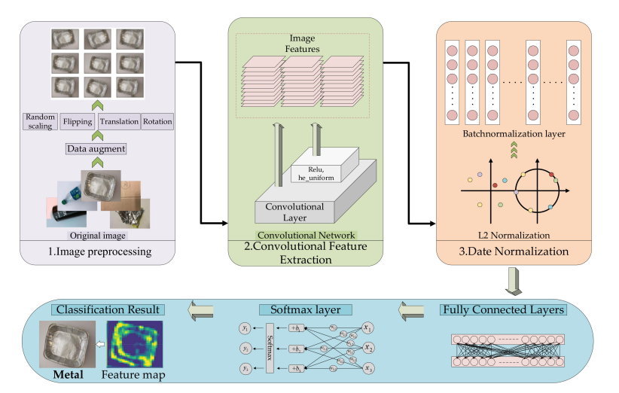
Existing Model/Architecture of your project

Slide 48
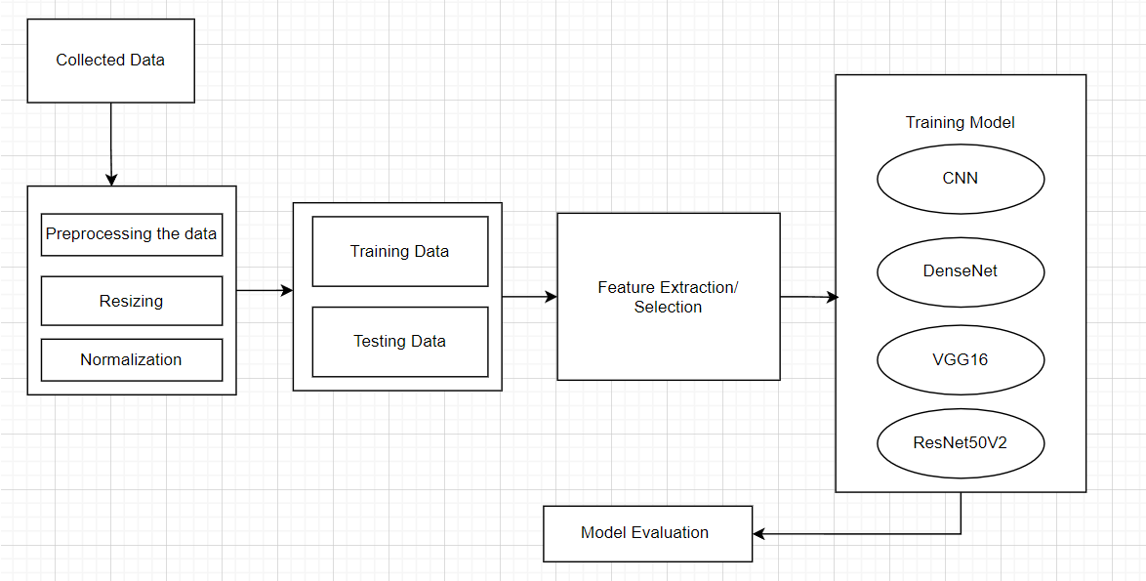
Proposed Model/Architecture of your project

Slide 49
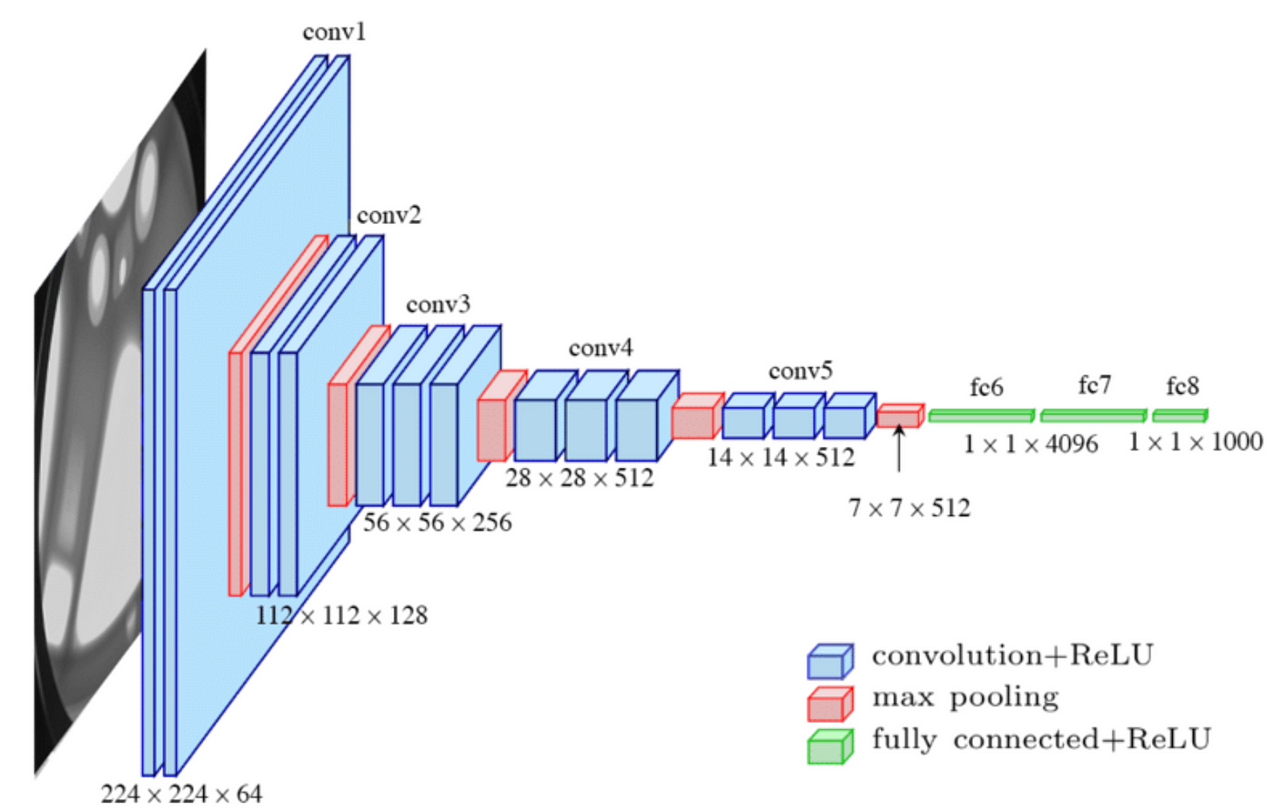
VGG-16 architecture

Slide 50
The architecture Receives the input image, typically represented as a multi-dimensional array with dimensions corresponding to its height, width, and channels (e.g., 224x224x3 for an RGB image).
Fundamental building blocks of CNNs that apply filters (kernels) to extract features from the input data. Each convolutional layer typically employs multiple filters and produces feature maps. In this architecture, convolutional layers use a 3x3 kernel size.
Activation function applied after most convolutional layers, introducing non-linearity by zeroing out negative values and leaving positive values unchanged.
Max pooling reduces the dimensionality of feature maps by down-sampling them, often using a 2x2 window to select the maximum value within each region. This helps decrease computational complexity and enhance network robustness to variations in input.
Fully connected layer located at the end of the network, these layers connect every neuron in one layer to every neuron in the next layer, enabling classification of the input image. The architecture includes two fully connected layers, each followed by a ReLU activation function.
Final layer of the network responsible for producing a probability distribution across classes. Particularly in image classification tasks, the number of classes corresponds to the potential objects the image could depict, with softmax ensuring output probabilities sum to 1, facilitating multi-class classification.

Slide 51
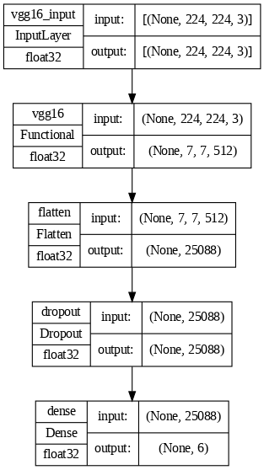

Slide 52
The process begins by loading the pre-trained VGG16 model.It defines the input shape for the model as (224, 224, 3) which represents images with 3 channels (RGB) and a resolution of 224x224 pixels.
The code loads the pre-trained weights from "imagenet".It then sets the trainable property of the base model to False, which means the weights of the pre-trained VGG16 model will not be updated during training.
Next, a sequential model is created using keras.models.Sequential.
The flowchart give if the include_top parameter when loading the VGG16 model was set to True.
If yes, an error message should be displayed indicating the top layers (classification layers) are already included in the loaded model, and adding another Dense layer might lead to unexpected behavior. This step is not explicitly shown in the code, but it's implied logically.
If no (which is the case in this code snippet), a Flatten layer is added to the sequential model. This layer flattens the multi-dimensional output of the convolutional layers from VGG16 into a single-dimensional vector.
A Dropout layer with a rate of 0.5 is added to the model. This layer randomly drops out 50% of the neurons during training to prevent overfitting.
Finally, a Dense layer with 6 units and a softmax activation function is added. The Dense layer creates a fully connected layer with 6 neurons, and the softmax activation ensures the output probabilities sum to 1, making it suitable for multi-class classification problems.

Slide 53
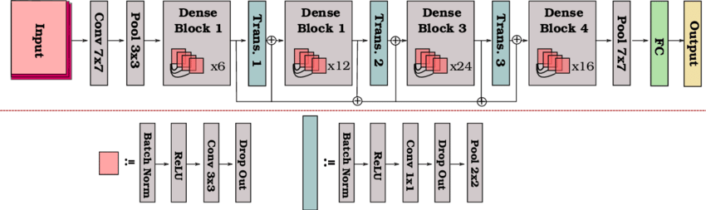
DenseNet Architecture

Slide 54
Dense Blocks are the building blocks of DenseNets and are represented by the four colored boxes (Dense Block 1, 2, 3, and 4) in the image. Each block consists of multiple convolutional layers stacked together. Unlike traditional CNNs, these convolutional layers are all connected to each other. This allows for better feature reuse and information flow throughout the network.
Convolution (Conv) layers (shown as Conv 3x3 in the image) are the fundamental blocks responsible for extracting features from the input image. They apply a filter (kernel) to the data and produce feature maps.
Batch Normalization is a technique is applied after each convolutional layer (shown as Batch Norm in the image) and helps to stabilize the training process and improve the speed of convergence.
ReLU (Rectified Linear Unit) activation function (shown as ReLU in the image) adds non-linearity to the network by setting all negative values to zero. It's used after most convolutional and Batch Normalization layers.
In Pooling The image shows a pooling layer (Pool 2x2) that reduces the dimensionality of the data by downsampling. This is typically achieved by selecting the maximum value from a subregion of the input (often a 2x2 square).
Transition Layers are Not included in the image, but essential to the DenseNet architecture, are transition layers. These layers are inserted between dense blocks and are used to reduce the number of feature maps. This helps to control the growth rate of the network and prevent it from becoming too computationally expensive.
Fully Connected (FC) Layer in the network (FC 1 in the image) is used for classification. It takes the features extracted by the convolutional layers and maps them to a specific class (e.g., cat, dog, airplane).

Slide 55
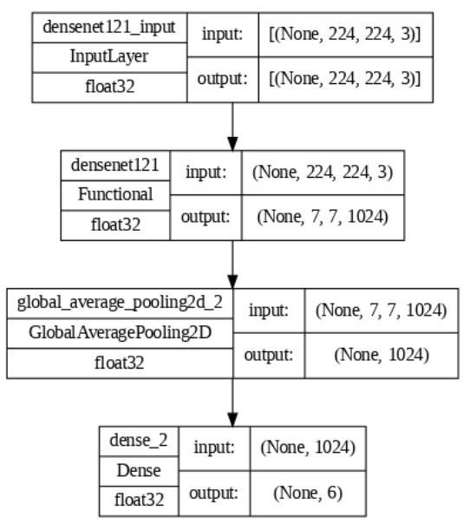

Slide 56
Input: The global average pooling layer typically receives a 3D tensor as input. This tensor represents the output of a convolutional layer, and it contains feature maps. Each feature map captures specific features extracted from the input image by the convolutional filters.
Average Pooling: In global average pooling, a single average value is calculated for each feature map. This is achieved by averaging all the elements within a feature map. The result is a 1D vector with the same number of elements as the number of feature maps in the input.
Output: This 1D vector becomes the output of the global average pooling layer. It represents a summarized version of the features extracted by the convolutional layer.

Slide 57
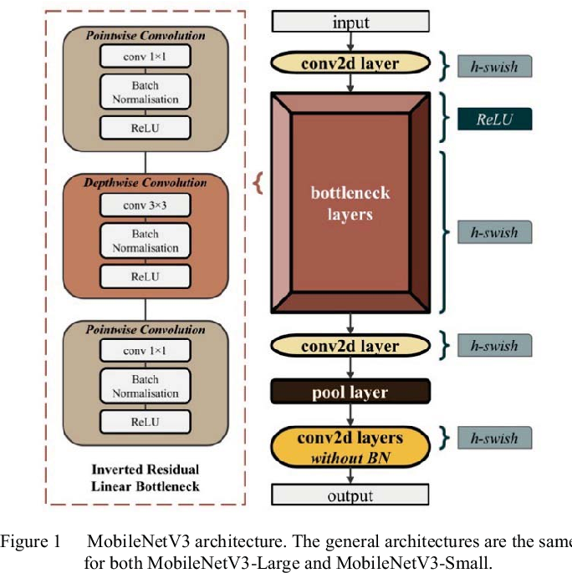

Slide 58
In MobileNetV3 for image classification, input images are preprocessed by resizing them to a fixed size (e.g., 224x224) and normalizing pixel values.
The network consists of lightweight depthwise separable convolution layers, applying depthwise convolutions independently to each channel followed by pointwise convolutions to adjust channel dimensions.
Activation functions like Hard Swish and Swish-6 introduce non-linearity for learning complex patterns.
Squeeze-and-Excitation (SE) blocks are used to selectively emphasize informative features by recalibrating channel-wise dependencies. After feature extraction, a global average pooling layer aggregates spatial information into a fixed-size representation.
A linear classifier (e.g., fully connected layer) then predicts class probabilities. MobileNetV3's design optimizes for efficiency and accuracy, making it suitable for image classification on resource-constrained devices.

Slide 59
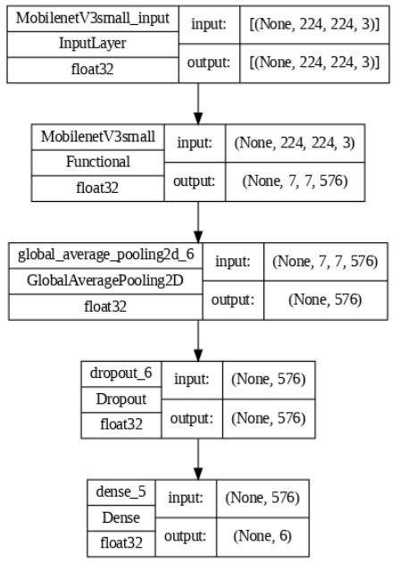

Slide 60
MobilenetV3small_input: This is the first layer of the model and it receives the input data.
MobilenetV3small: This is a pre-trained convolutional neural network (CNN) that extracts features from the input data. It is likely a lightweight version of the EfficientNet model, designed for mobile applications due to its computational efficiency.
GlobalAveragePooling2D: This layer reduces the spatial dimensions of the data by averaging the values in each feature map. This helps to prepare the data for the fully-connected layers.
Dropout: This layer randomly drops a certain percentage of activations during training to prevent overfitting.
Dense: This layer is a fully-connected layer that takes the features extracted by the convolutional layers and maps them to a probability of patient survival.

Slide 61
Results
 | Precision | Precision | F1-score | Support | Accuracy
Cardboard | 0.94 | 0.97 | 0.95 | 30 | 0.96
Glass | 0.95 | 0.92 | 0.94 | 39 | 0.92
Metal | 1.00 | 0.94 | 0.97 | 36 | 0.94
Paper | 0.95 | 0.98 | 0.96 | 56 | 0.98
Plastic | 0.91 | 0.91 | 0.88 | 0.88 | 0.87
Trash | 0.88 | 1.00 | 0.93 | 14 | 1.00

Slide 62
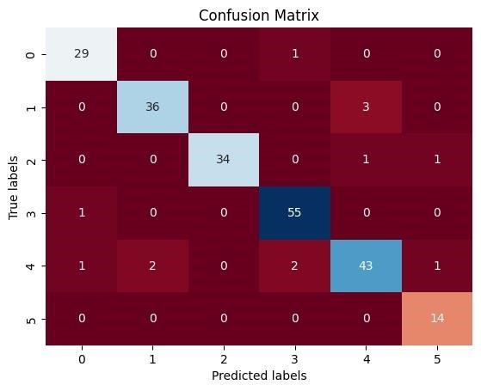
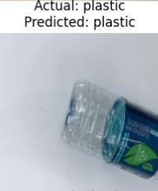
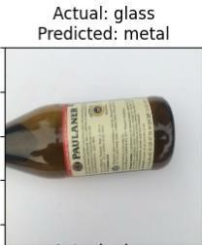
Fig : Confusion metrics Fig: Actual and predicted images

Slide 63
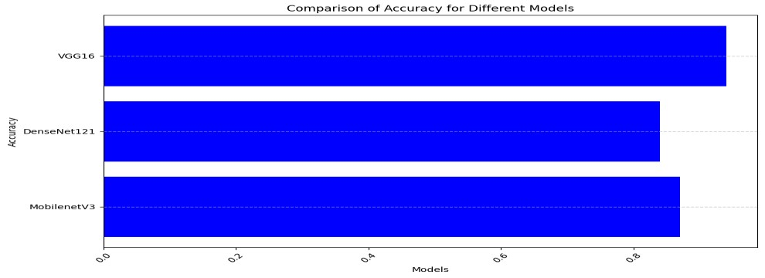
Model | Train Accuracy | Test Accuracy
VGG 16 | 98% | 94.19
Densenet121 | 93% | 84.82%
MobilenetV3 | 82.9 | 87.05
Table : Experiment results
Fig :Comparison of accuracy on different models

Slide 64
Conclusion
In this study, the implementation of the VGG16 model yielded remarkable results, achieving an impressive accuracy of 94% on the test data, outperforming both DenseNet121 (84% accuracy) and MobileNetV3 (87% accuracy). This highlights the model's high efficiency in classifying garbage images, underscoring its effectiveness in waste management applications. The success of VGG16 underscores its potential to contribute significantly to reducing garbage in our surroundings. With its robust classification capabilities, VGG16 holds promise for enhancing waste sorting processes and ultimately promoting cleaner environments.
Moving forward, future work could involve leveraging feature maps to further enhance garbage detection and classification systems. By utilizing tools like OpenCV, a versatile system for detecting various images, including cars, could be developed. With advancements in image detection, this system could be expanded to effectively identify a wide variety of trash, including ocean debris. Additionally, the development of a website or mobile app where users can upload images for classification could be explored. Handheld or portable machines for image detection could also be designed to aid in tasks such as beach garbage collection. Ultimately, these advancements could lead to the creation of robots

Slide 65
References
1) Shi, C., Tan, C., Wang, T., & Wang, L. (2021). A waste classification method based on a m0ultilayer hybrid convolution neural network. Applied Sciences, 11(18), 8572.
2) Melinte, D. O., Travediu, A. M., & Dumitriu, D. N. (2020). Deep convolutional neural networks object detector for real-time waste identification. Applied Sciences, 10(20), 7301.
3) Kang, B., & Jeong, C. S. (2023). ARTD-Net: Anchor-Free Based Recyclable Trash Detection Net Using Edgeless Module. Sensors, 23(6), 2907.
4) Yang, J., Zeng, Z., Wang, K., Zou, H., & Xie, L. (2021). GarbageNet: a unified learning framework for robust garbage classification. IEEE Transactions on Artificial Intelligence, 2(4), 372-380.
5) Chen, Z., Yang, J., Chen, L., & Jiao, H. (2022). Garbage classification system based on improved ShuffleNet v2. Resources, Conservation and Recycling, 178, 106090
6) Wahyutama, Aria Bisma, and Mintae Hwang. "YOLO-based object detection for separate collection of recyclables and capacity monitoring of trash bins." Electronics 11.9 (2022): 1323
7) Sultana, Rumana, et al. "Trash and recycled material identification using convolutional neural networks (CNN)." 2020 SoutheastCon. IEEE, 2020.
8) Yang, Jianfei, et al. "GarbageNet: a unified learning framework for robust garbage classification." IEEE Transactions on Artificial Intelligence 2.4 (2021): 372-380

Slide 66
9) Teng, X., Fei, Y., He, K., & Lu, L. (2022, July). The Object Detection of Underwater Garbage with an Improved YOLOv5 Algorithm. In Proceedings of the 2022 International Conference on Pattern Recognition and Intelligent Systems (pp. 55-60).
10) Gondal, A. U., Sadiq, M. I., Ali, T., Irfan, M., Shaf, A., Aamir, M., ... & Kantoch, E. (2021). Real time multipurpose smart waste classification model for efficient recycling in smart cities using multilayer convolutional neural network and perceptron. Sensors, 21(14), 4916.
11) Xiao, J. (2022, March). A waste image classification using convolutional neural networks and ensemble learning. In Proceedings of the 6th International Conference on Control Engineering and Artificial Intelligence (pp. 29-33).
12) Ma, Xiaoxuan, Zhiwen Li, and Lei Zhang. "An improved ResNet-50 for garbage image classification." Tehnički vjesnik 29.5 (2022): 1552-1559. Page 56 Department of CSE, GMRIT Enhancing Waste Management Through Deep learning -Based Trash Classification 2024
13) Mittal, Ishika, et al. "Trash classification: classifying garbage using deep learning." Journal of engineering sciences 11.7 (2020).
14) Pandey, Ayush, et al. "Enhancing Waste Management: Automated Classification of Biodegradable and Non-biodegradable Waste using CNN

Slide 67
15) Ramsurrun, Nadish, et al. "Recyclable waste classification using computer vision and deep learning." 2021 zooming innovation in consumer technologies conference (ZINC). IEEE, 2021.
16) Wang, Y., Zhao, W. J., Xu, J., & Hong, R. (2020). Recyclable waste identification using cnn image recognition and gaussian clustering. arXiv preprint arXiv:2011.01353.
17) Yang, M., & Thung, G. (2016). Classification of Trash for Recyclability Status; CS229 Project Report.
18) He, Y., Gu, Q., & Shi, M. (2020). Trash Classification Using Convolutional Neural Networks Project Category: Computer Vision.
19) Awe, O., Mengistu, R., & Sreedhar, V. Final Report Smart Trash Net Waste Localization and Classification. arXiv 2017. Preprint.
20) Kulkarni, Hrushikesh N., and Nandini Kannamangalam Sundara Raman. "Waste object detection and classification." CS230 Stanford (2019).

Slide 68
THANKYOU

